Slide 1
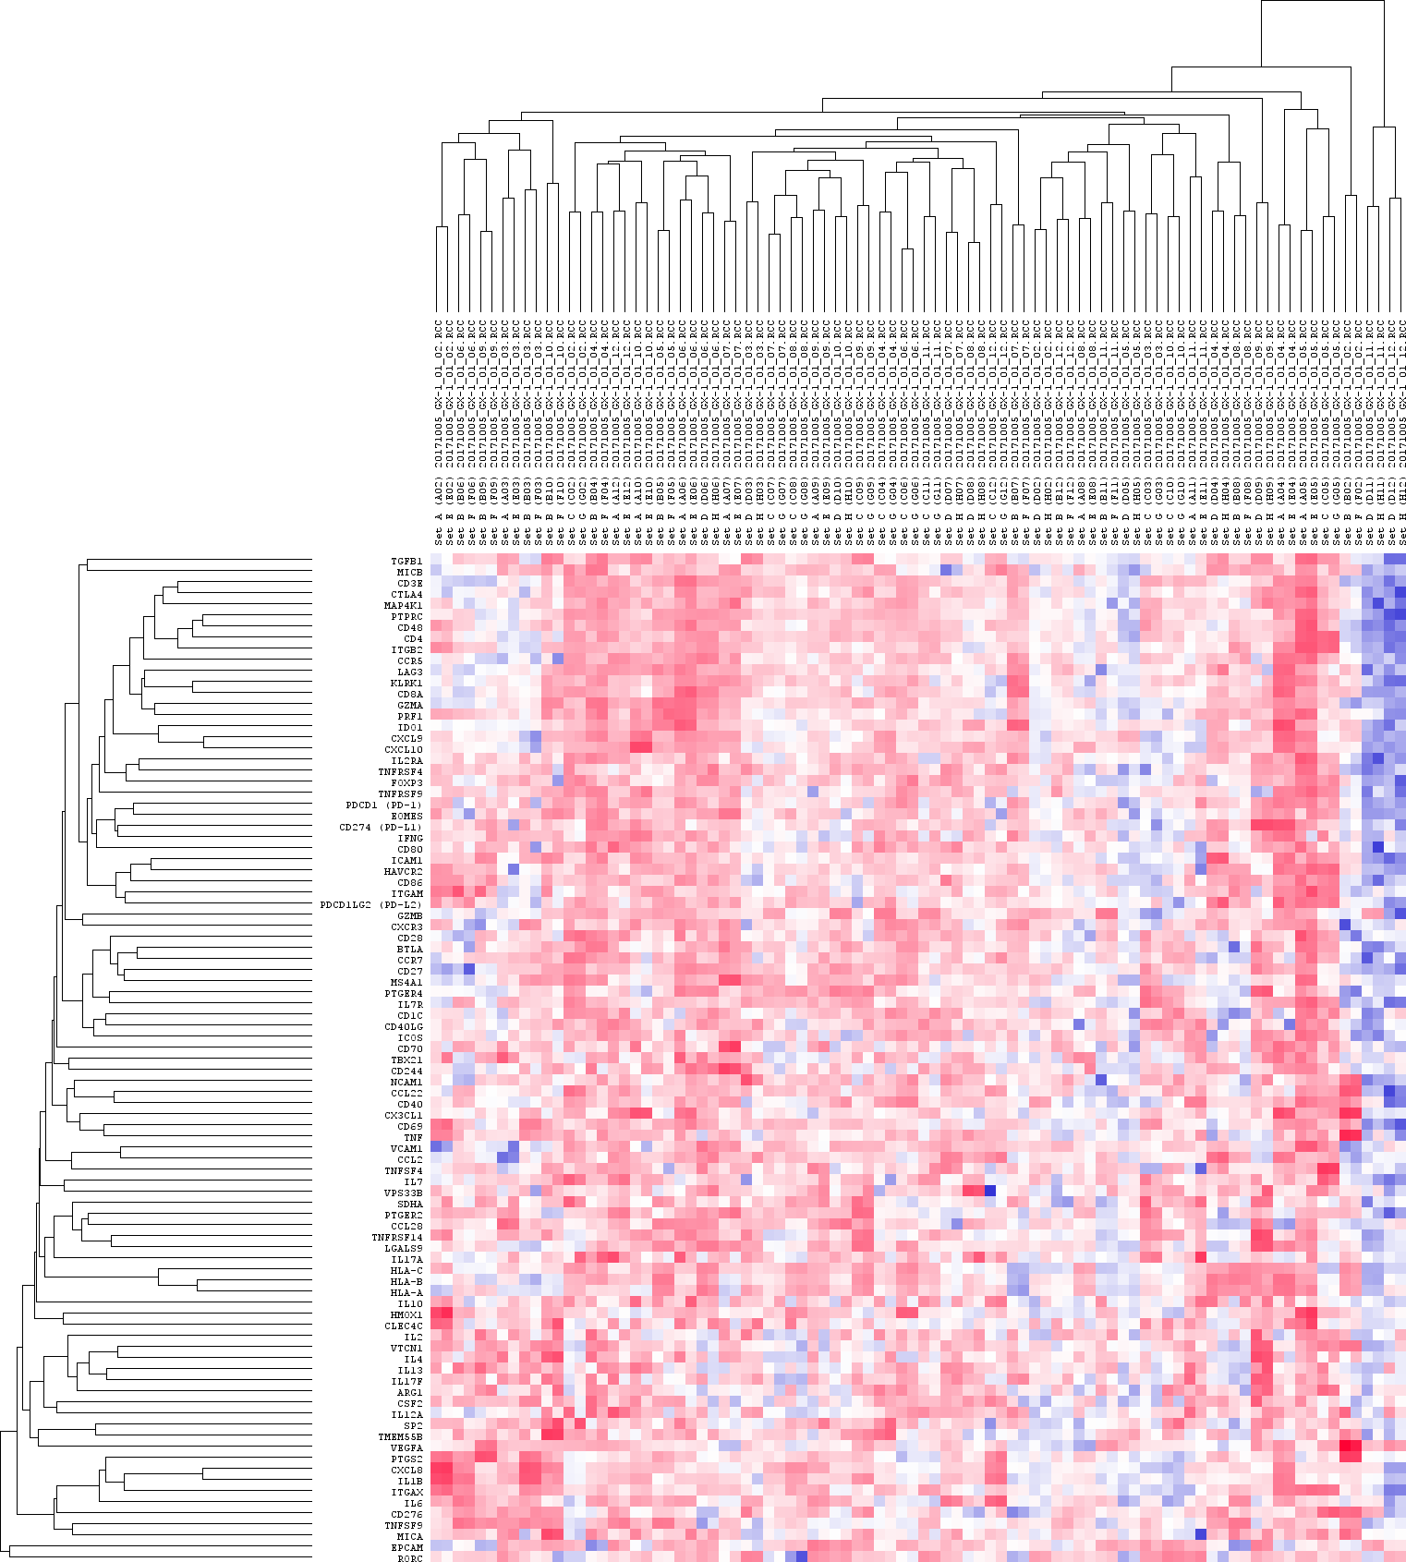
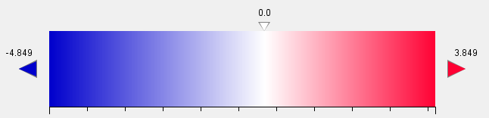
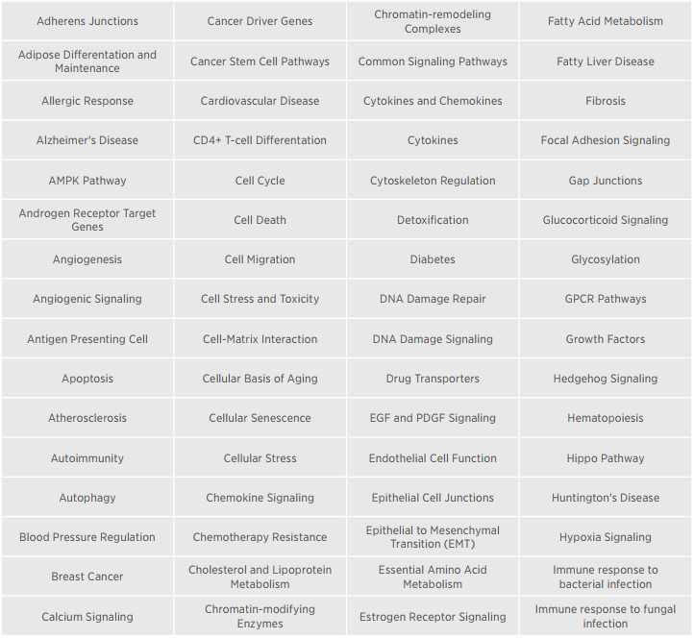
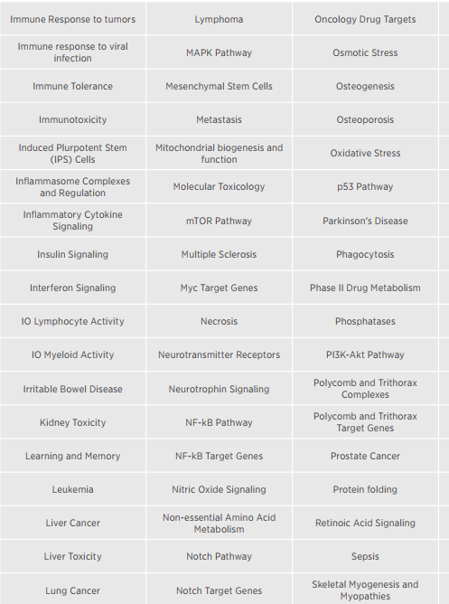
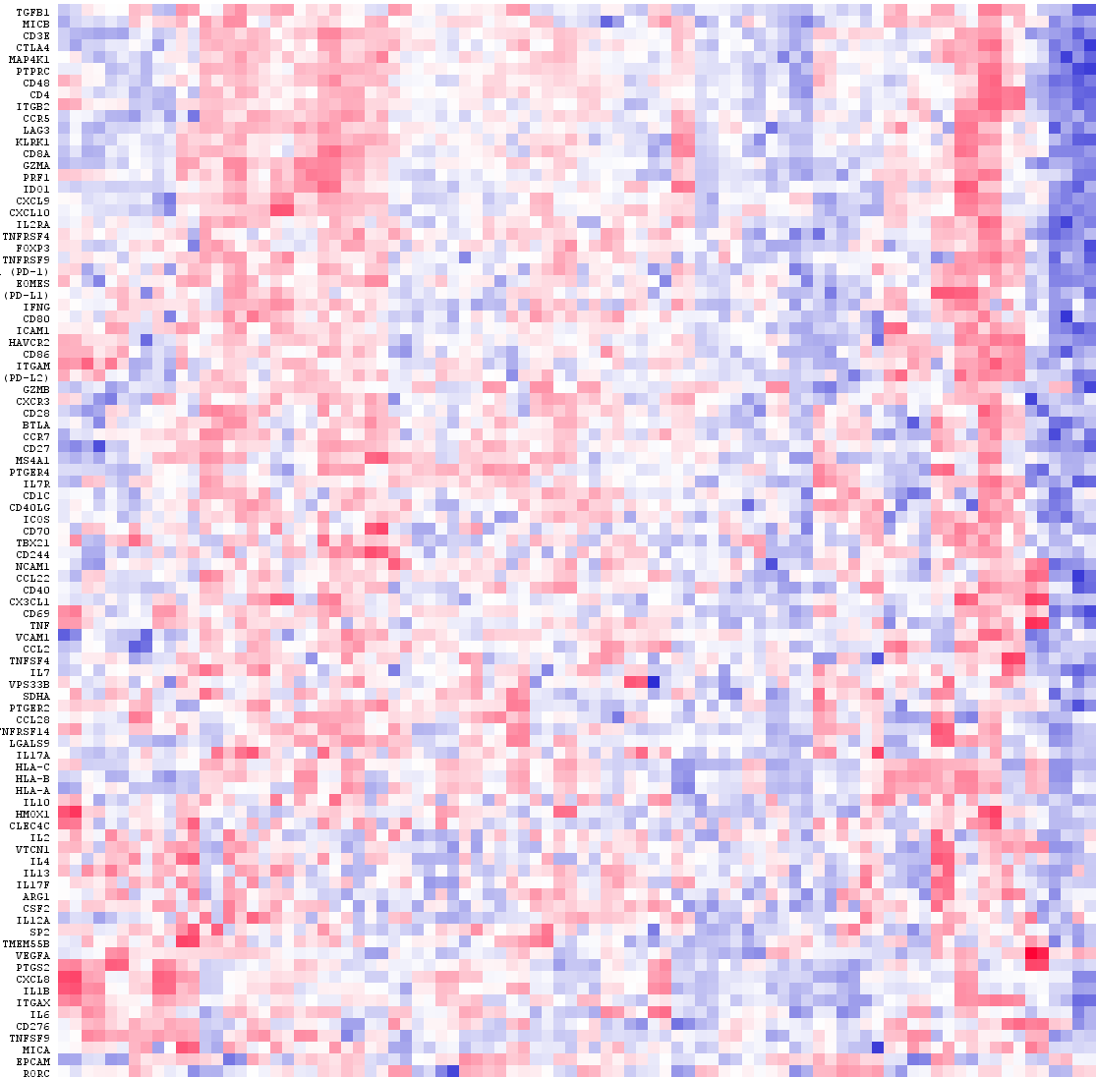
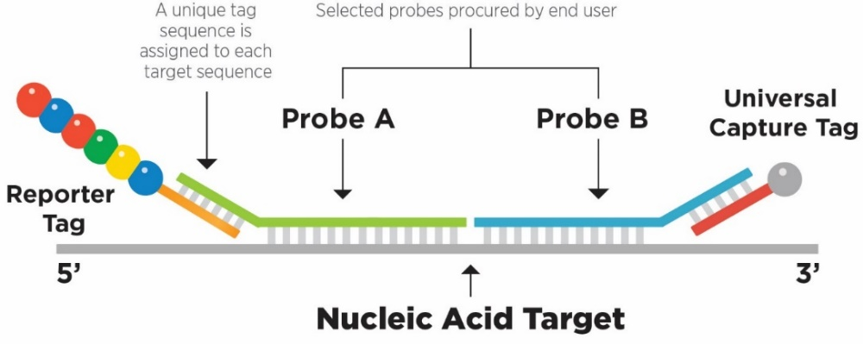
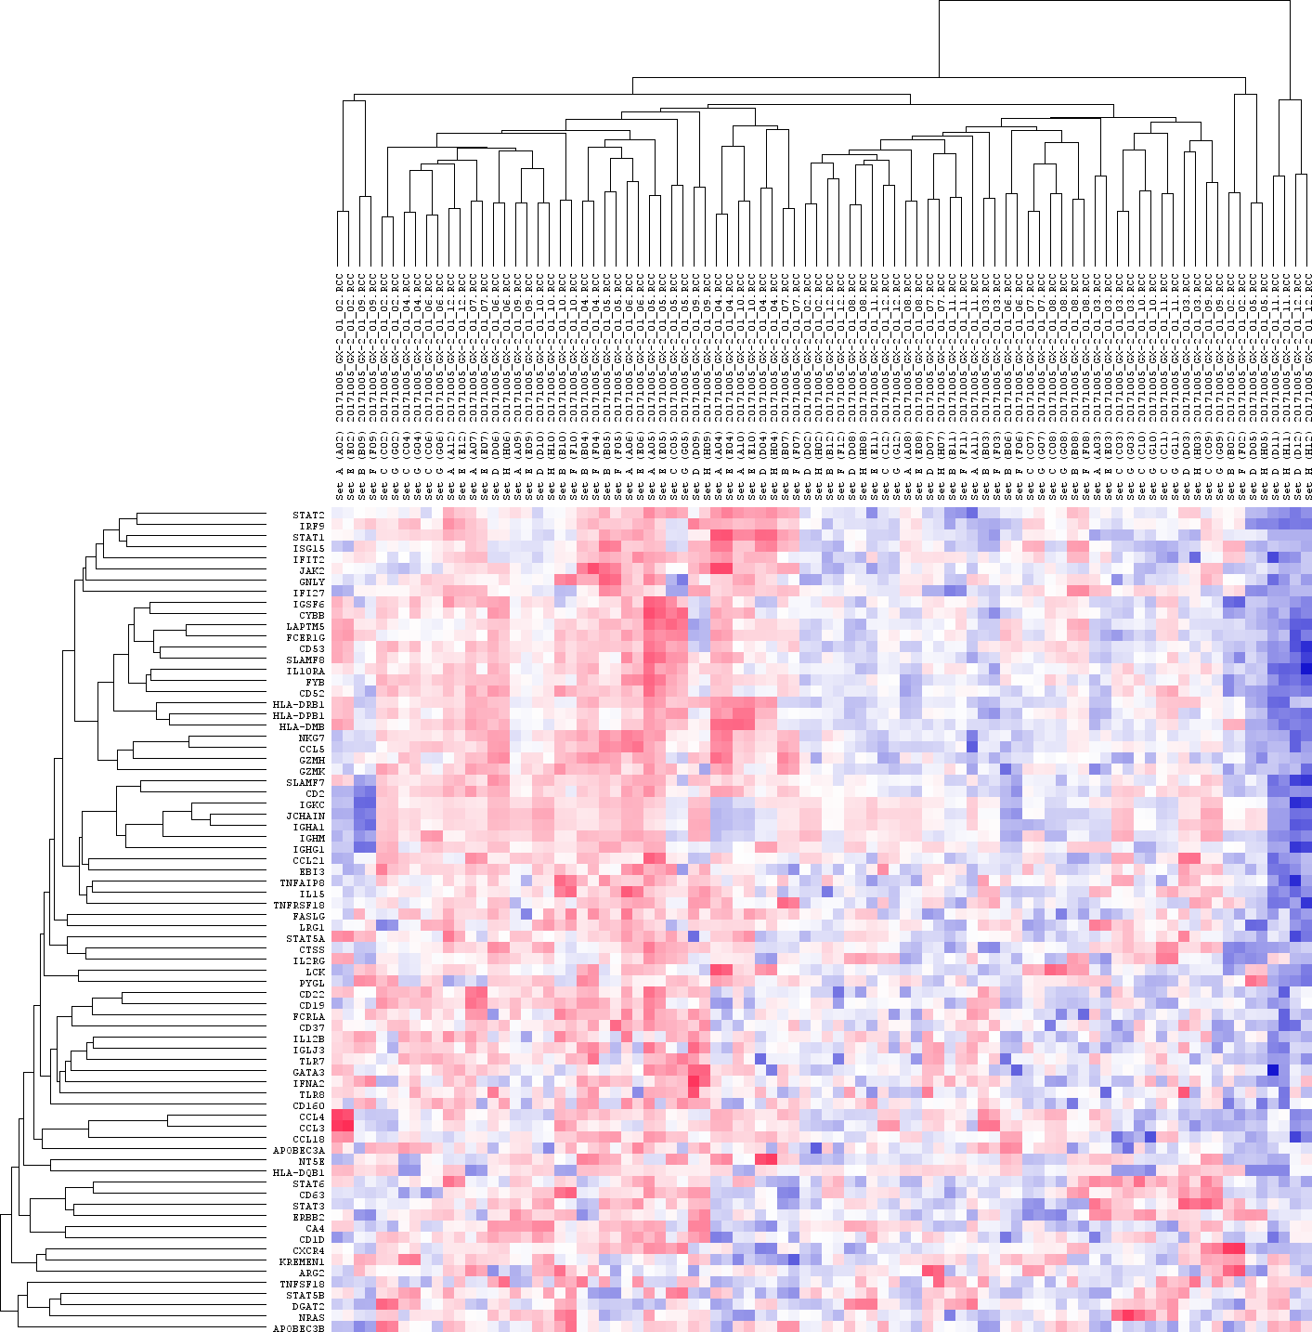
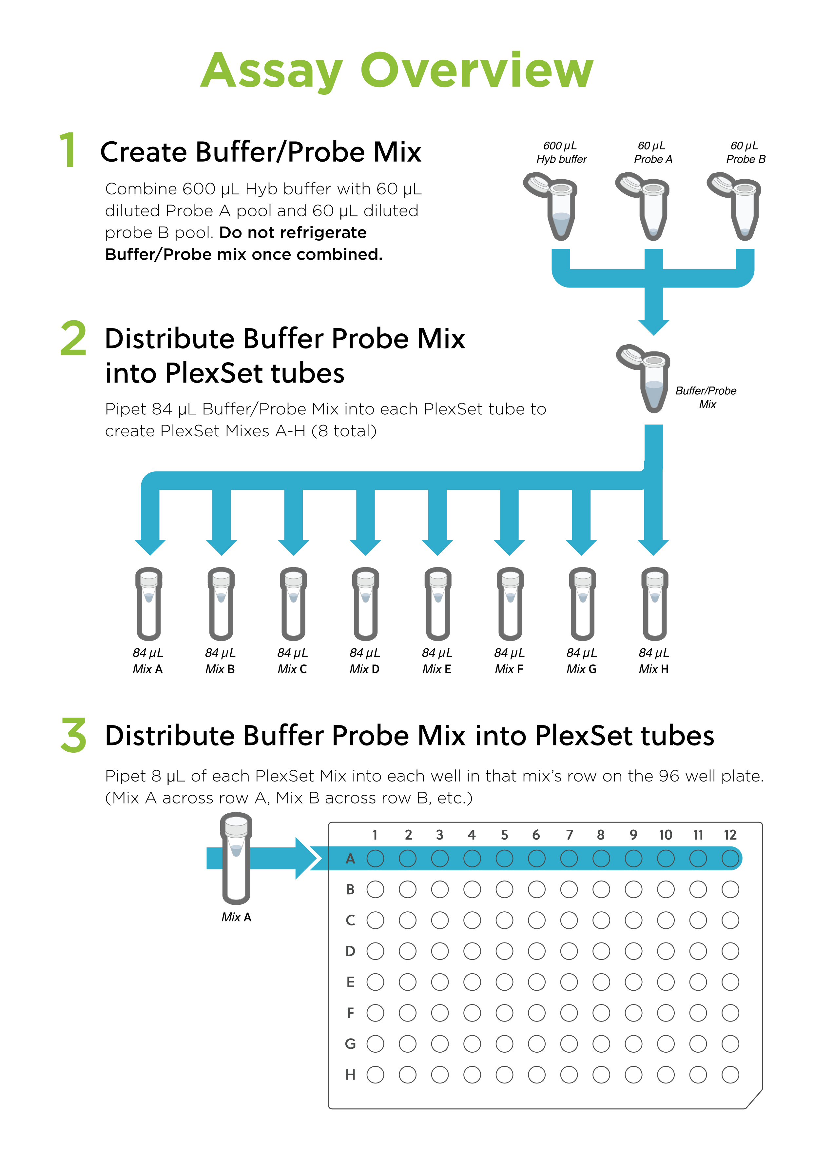
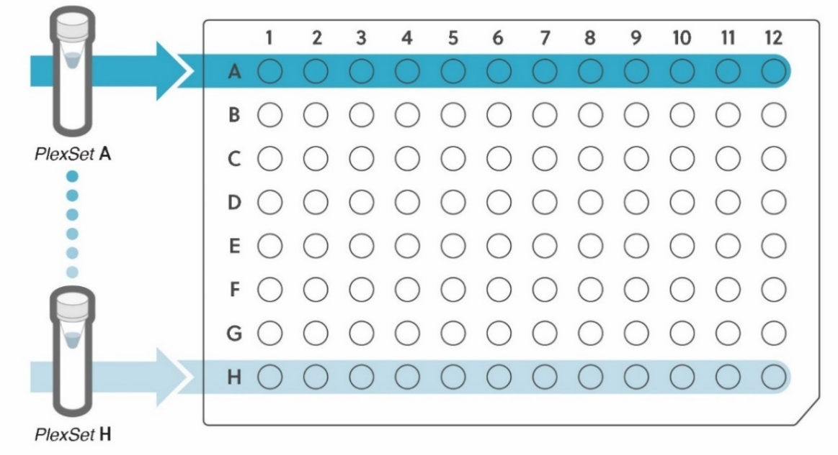
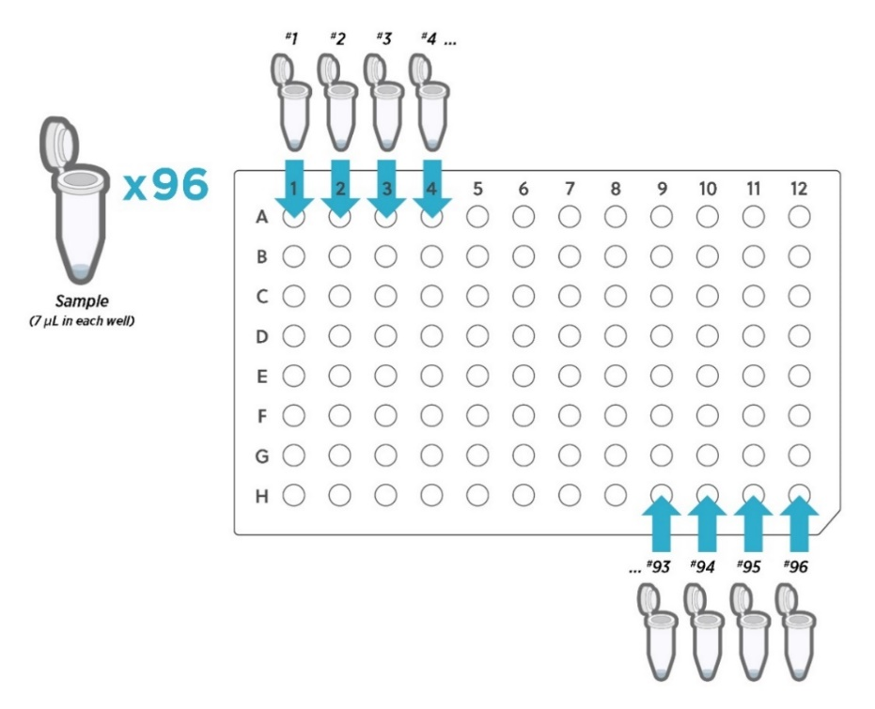
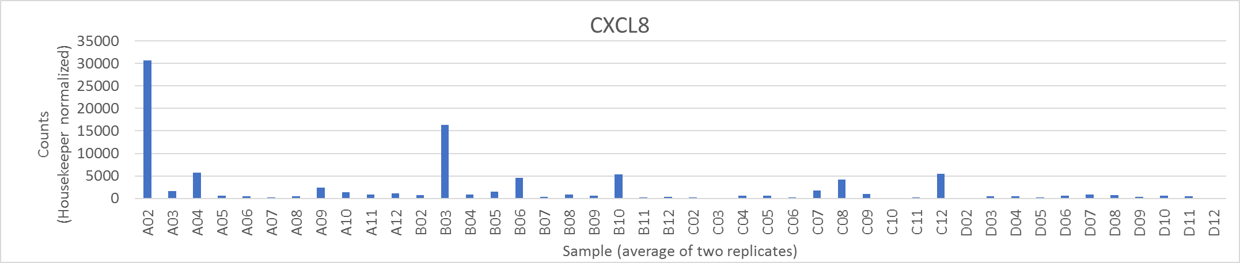
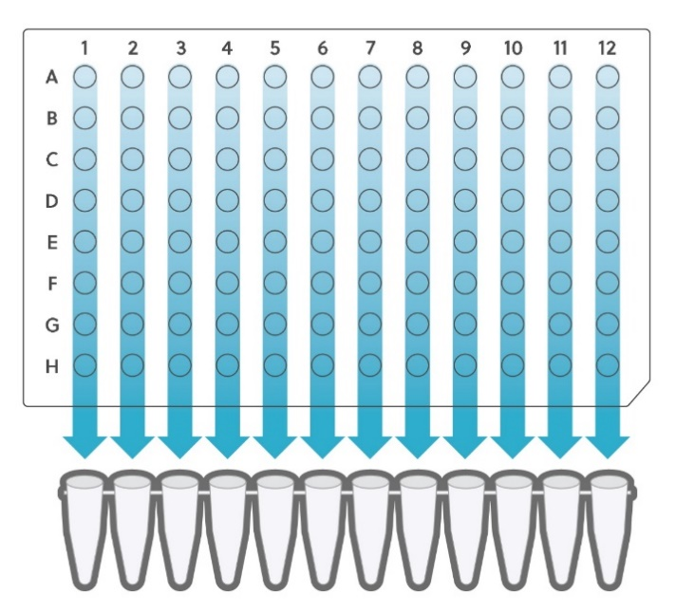
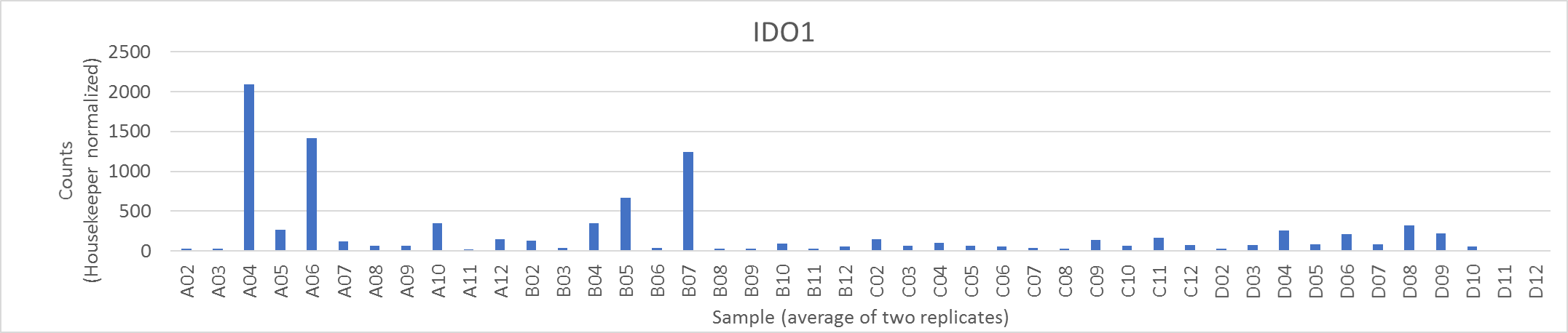

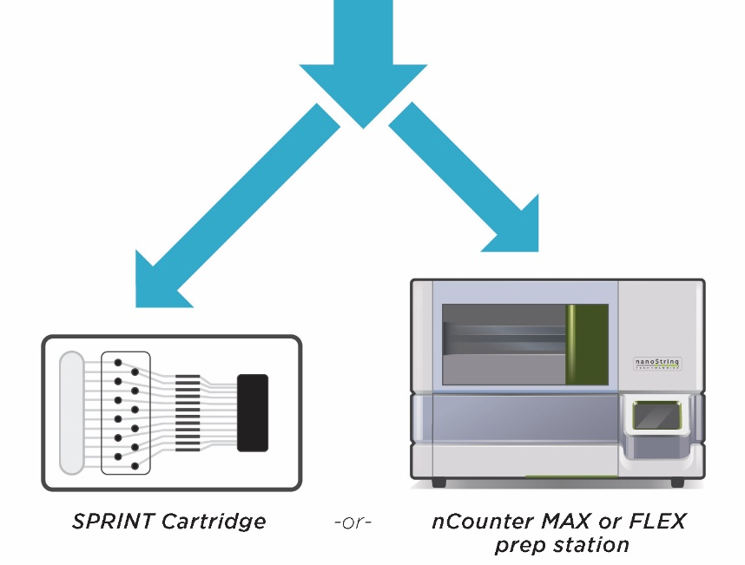
Digital gene expression of up to 96 multiplexed targets in 96 samples with nCounter® PlexSet™ Reagents
Giang Ong, Chris Merritt, Anisha Kharkia, and Philippa Webster
Abstract
nCounter PlexSet suite of preselected pathway panels is a one stop shop for gene targets of interest but still allows for customization
96 targets profiled in 96 samples: nCounter PlexSet assay for gene expression generates up to 9,216 data points in a single nCounter run
The NanoString nCounter Analysis platform uses a novel molecular barcoding technology to measure multiplexed gene expression of up to 800 targets. The assay counts fluorescent barcodes hybridized to targets to provide precise digital data. The standard nCounter gene expression assay can be used to process 12 samples per run. We recognize an additional need for a higher sample-throughput assay which would enable researchers to quickly evaluate tens of multiplexed targets in hundreds of samples. Here we present data from a new nCounter assay, nCounter PlexSet Reagents for gene expression, which is performed in a 96-sample format and is capable of digitally profiling up to 96 gene targets per sample. We used two preselected pathway panels for IO Lymphocyte Activity (96 gene targets) and IO Myeloid Activity (79 gene targets), chosen from our 400+ preselected pathway panels list, in order to evaluate the presence of immune signatures in 44 colorectal cancer (CRC) samples. Each CRC sample was ran in duplicates across the two panels in addition to a Reference Sample to calibrate for variability between PlexSet reagents. The results show that the PlexSet reagents for gene expression provides highly reproducible data with an average R² > 95% between duplicate samples.
Nanostring® provides a list of 400 + preselected panels covering ~140 biological pathways and fields of interest for human, mouse, and rat samples
Each panel contains up to 96 genes including housekeeping genes, chosen to comprehensively cover each pathway involved in the topic.
All necessary controls and reference genes are included in each panel.
Customize by adding additional genes of interest to the panels (or omitting genes that are not of interest).
Up to 96 samples can be run in a single nCounter run.
Compressed list is shown below:
A
IO Lymphocyte Activity
nCounter PlexSet Chemistry
nCounter PlexSet Tag Complex. Customized oligonucleotide probes hybridize with general purpose Reporter and Capture Tags and the target nucleic acid to create a Tag Complex. The digital readout on the nCounter platform is the 6 color fluorescent Reporter Tag.
B
Myeloid Activity
nCounter PlexSet Reagents Workflow
In order to better understand the immune signatures present in 44 colorectal cancers, we focused on two preselected panels: IO Lymphocyte Activity and IO Myeloid Activity Panels. The gene list for both panels are below.
1
IO Lymphocyte Activity Panel Gene List
POLR2A | CD70 | IDO1 | NCAM1
HPRT1 | CD80 | IFNG | PDCD1 (PD-1)
GUSB | CD86 | IL10 | PDCD1LG2 (PD-L2)
G6PD | CD8A | IL12A | PRF1
ABCF1 | CLEC4C | IL13 | PTGER2
ARG1 | CSF2 | IL17A | PTGER4
BTLA | CTLA4 | IL17F | PTGS2
CCL2 | CX3CL1 | IL1B | PTPRC
CCL22 | CXCL10 | IL2 | RORC
CCL28 | CXCL8 | IL2RA | SDHA
CCR5 | CXCL9 | IL4 | SP2
CCR7 | CXCR3 | IL6 | TBX21
CD1C | EOMES | IL7 | TGFB1
CD244 | EPCAM | IL7R | TMEM55B
CD27 | FOXP3 | ITGAM | TNF
CD274 (PD-L1) | GZMA | ITGAX | TNFRSF14
CD276 | GZMB | ITGB2 | TNFRSF4
CD28 | HAVCR2 | KLRK1 | TNFRSF9
CD3E | HLA-A | LAG3 | TNFSF4
CD4 | HLA-B | LGALS9 | TNFSF9
CD40 | HLA-C | MAP4K1 | VCAM1
CD40LG | HMOX1 | MICA | VEGFA
CD48 | ICAM1 | MICB | VPS33B
CD69 | ICOS | MS4A1 | VTCN1
IO Myeloid Activity Panel Gene List
POLR2A | CD52 | HLA-DRB1 | LCK
HPRT1 | CD53 | IFI27 | LRG1
GUSB | CD63 | IFIT2 | NKG7
G6PD | CTSS | IFNA2 | NRAS
ABCF1 | CXCR4 | IGHA1 | NT5E
APOBEC3A | CYBB | IGHG1 | PYGL
APOBEC3B | DGAT2 | IGHM | SLAMF7
ARG2 | EBI3 | JCHAIN | SLAMF8
CA4 | ERBB2 | IGKC | STAT1
CCL18 | FASLG | IGLJ3 | STAT2
CCL21 | FCER1G | IGSF6 | STAT3
CCL3 | FCRLA | IL10RA | STAT5A
CCL4 | FYB | IL12B | STAT5B
CCL5 | GATA3 | IL15 | STAT6
CD160 | GNLY | IL2RG | TLR7
CD19 | GZMH | IRF9 | TLR8
CD1D | GZMK | ISG15 | TNFAIP8
CD2 | HLA-DMB | JAK2 | TNFRSF18
CD22 | HLA-DPB1 | KREMEN1 | TNFSF18
CD37 | HLA-DQB1 | LAPTM5
1
Create Hybridization Buffer and Probe Mix and aliquot to 8 PlexSet tube
2
Distribute PlexSet Master mixes into 96-well plate
Information for 44 FFPE adenocarcinoma
colorectal cancer samples
Highly reproducible results with average
R² >95% between all technical replicates
Well | Block Label ID | Tumor Area (%) | Tumor Cellularity (%) |  | Well | Block Label ID | Tumor Area (%) | Tumor Cellularity (%)
A02 | 15-966 | 100% | 0.35 |  | C02 | 16-386 | 100% | 0.35
A03 | 13-188 | 100% | 0.75 |  | C03 | 16-1032 | 25% | 0.01
A04 | 13-293 | 100% | 0.55 |  | C04 | 15-473 | 100% | 0.3
A05 | 13-437 | 50% | 0.35 |  | C05 | 16-551 | 100% | 0.1
A06 | 14-138 | 100% | 0.35 |  | C06 | 14-496 | 100% | 0.25
A07 | 14-545 | 100% | 0.45 |  | C07 | 16-330 | 100% | 0.55
A08 | 14-615 | 100% | 0.4 |  | C08 | 17-306 | 100% | 0.35
A09 | 15-490 | 50% | 0.25 |  | C09 | 15-800 | 0% | 0
A10 | 15-632 | 100% | 0.6 |  | C10 | 16-647 | 100% | 0.15
A11 | 15-729 | 100% | 0.45 |  | C11 | 16-095 | 100% | 0.15
A12 | 15-958 | 100% | 0.6 |  | C12 | 16-239 | 100% | 0.2
B02 | 14-411 | 100% | 0.55 |  | D02 | 16-316 | 96% | 0.4
B03 | 15-029 | 100% | 0.2 |  | D03 | 16-320 | 32% | 0.3
B04 | 14-774 | 100% | 0.5 |  | D04 | 16-571 | 100% | 0.55
B05 | 16-362 | 100% | 0.4 |  | D05 | 16-574 | 100% | 0.4
B06 | 14-196 | 100% | 0.55 |  | D06 | 16-652 | 55% | 0.15
B07 | 15-768 | 100% | 0.6 |  | D07 | 16-580 | 100% | 0.4
B08 | 15-012 | 100% | 0.45 |  | D08 | 17-115 | 100% | 0.6
B09 | 15-137 | 100% | 0.3 |  | D09 | 15-156 | 0% | 0
B10 | 14-596 | 100% | 0.65 |  | D10 | 14-419 | 52% | 0.1
B11 | 15-058 | 100% | 0.3 |  | D11 | 16-237 | 93% | 0.35
B12 | 14-707 | 100% | 0.3 |  | D12 | 17-020 | 100% | 0.65
Cluster map of samples profiled using IO Lymphocyte and Myeloid Activity Panels. 44 colorectal cancer samples from CellNetix were multiplexed using the nCounter PlexSet Gene Expression assay. The input amount per sample was 100 ng of purified RNA. Each CRC sample was ran in duplicates in addition to a reference sample using the IO Lymphocyte Activity (96 gene targets) and IO Myeloid Activity (79 gene targets) panels in separate 96-well PCR plates. Data was normalized to positive internal controls and normalized to a reference sample. Using the Euclidean distance and average linkage method, two unsupervised cluster maps were generated using nSolver 4.0. Clustermap A and clustermap B show the data for the IO Lymphocyte Activity and IO Myeloid Activity panels, respectively. As expected, technical CRC sample replicates are clustering together (with an average R² > 0.95) demonstrating the reproducibility of the assay. In addition, we are able to able to detect CRC samples with high levels of lymphocyte and myeloid activity.
3
Add sample to each of the 96 wells and hybridize 96-well plate at 67°C overnight
Steps 1 to Step 3 is about 30 minutes of hands-on time
4
Pool hybridizations down columns into a 12-strip tube
Colorectal cancer patient information from CellNetix. RNA from 3X FFPE slides per sample were isolated using Qiagen Rneasy FFPE kit.
R² values between technical replicates. The scatter plot figure above show four representative scatter plots between technical replicates ran using PlexSet-96 assay. The bar plot figure below show R² values between all technical replicates ran on Lymphocyte and Myeloid Activity Panels using the nCounter PlexSet-96 Assay.
Bar graphs of differential CXCL8 and IDO1 gene expression across 44 colorectal samples. Counts were housekeeper normalized and the average of each technical duplicate are plotted. CXCL8 encodes for Interleukin 8, a chemokine produced by macrophages and is a key mediator associated with inflammation. IDO1 encodes for the IDO enzyme that plays an important role in immune modulation and has been shown to allow tumor cells to escape the immune system.
5
Process strip tube directly on either nCounter MAX or Flex Prep Station or load 35 μL of each pool into SPRINT cartridge
Conclusions and Ongoing Development
Detect up to 96 gene targets across 96 samples to generate 9,216 data points per run
Digital gene expression provides accurate reproducible results
No upfront probe optimization required
PlexSet assay setup is about 30 minutes of hands-on time
Currently, we are optimizing a “Lyse-and-Go” protocol for cell line screening using the nCounter PlexSet assay*
*In Early access now; contact at support@nanostring.com
nCounter PlexSet Gene Expression has a simplified workflow. 1) Create hybridization/probe master mix and distribute to 8 PlexSet tubes. 2) Distribute each PlexSet master mix across respective row. 3) Add prepared sample to each well and hybridize overnight 4) Pool hybridization down the column into a strip tube. 5) Process strip tube on any nCounter platform.
AUTHORS: Giang Ong, Chris Merritt, Anisha Kharkia, and Philippa Webster
18 Oct 2017

